Slide 1
Comparative analysis of plant leaf disease detection using machine learning
Specimen: Tomato Leaves

Slide 2
Abstract
The quality and quantity of the crop are significantly affected by numerous diseases in plants. In this regard, an early detection of such diseases is highly effective. Tomato is one of the important crops that is produced in large quantities with high commercial value. Several types of tomato diseases affect the crop at an alarming rate. The aim of this thesis is to implement three different machine learning models, namely, Convolution Neural Networks (CNN) and K-nearest Neighbors (KNN) for the application of plant disease detection in tomato leaves. The two machine learning models were evaluated on four different metrics in order to find the best performing model among the two. The four different metrics were, Accuracy, Precision, Recall and F1-Score. The results on implementing the machine learning models showed that the KNN model performed better than the CNN model in all of the evaluation metrics.

Slide 3
Table Of Content
Introduction
Literary Survey
Methodology
Tools And Technology
Working Leaf
Types of Diseases
Result
Conclusion
Future Scope
References

Slide 4
Introduction
Plant diseases are an important in the crops production, which affects food security and reduces the profit of farmers. Identifying the diseases in plants is the key to avoiding losses by proper feeding measures to cure the diseases early and avoiding the reduce in production.
India the third largest county of the tomato producer in the world. Disease affected the plant’s production in 10-30% of the total loss. Identification of such diseases in the plant is very important in preventing any heavy losses. In paper contains the most common diseases found in the tomato plant like, Bacterial leaf spot and Septoria leaf spot, Yellow Leaf Curl and many others.
The aim of this is to develop a software system answer that mechanically find and classify disease. That consist steps like image acquisition, pre-Processing, Segmentation, extraction and classification are involves disease detection.

Slide 5
The k-nearest neighbors algorithm, also known as KNN or k-NN, is a non-parametric, supervised learning classifier, which uses proximity to make classifications or predictions about the grouping of an individual data point.
CNN is a type of deep learning model for processing data that has a grid pattern, such as images, which is inspired by the organization of animal visual cortex and designed to automatically and adaptively learn spatial hierarchies of features, from low- to high-level patterns.
Machine learning (ML) is the study of algorithms and mathematical models that computer systems use to progressively improve their performance on a specific task. Machine learning algorithms build a mathematical model of sample data, known as "training data", in order to make predictions or decisions without being explicitly programmed to perform the task.
Image processing is any form of processing for which the input is an image or a series of images or videos, such as photographs or frames of video. The output of image processing can be either an image or a set of characteristics or parameters related to the image. It also means "Analysing and manipulating images with a computer".

Slide 6
Literature Survey
Yashpal Sen, Chandra Shekar Mithlesh, Dr. Vivek Baghel
Sandesh Raut, Karthik Ingale
Sagar Patil, Anjali chandavale
T. RUMPf, A-K , Mahlein, U.Steiner , E-C Oerke
Savita N Ghaiwat, Parul Arora
S Arivazhagan, R Newlin shebiah, S Ananthi, S Vishnu varthini
Sunku Rohan , Triveni S Pujar ,Suma VR Amog Shetty, Rishabh F Tated
Omkar Kulkarni
Sandesh Raut, Karthik Ingale
Prajwala TM, Alla Pranathi, Kandiraju Sai Ashritha, Nagaratna B. Chittaragi, Shashidhar G. Koolagudi

Slide 7
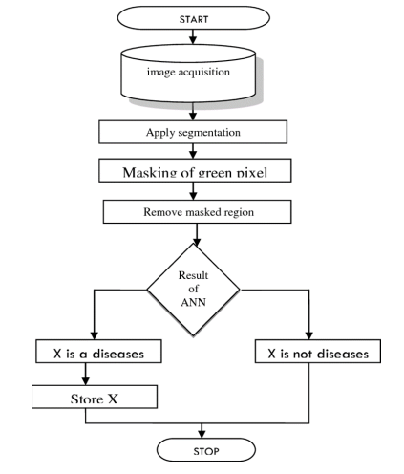
Methodology

Slide 8
Tools and Technology
Python: Python as a language has a huge community behind it. Any issues you encounter can be easily resolved by simply visiting Stack Overflow. Since Python is one of the leading standard languages ​​in positioning, it's very likely that you'll get a clear answer to every question. Such packages greatly reduce and modify the code required to create a given program. This makes iterations faster.
NUMPY: NumPy is a Python package that provides scientific and high-level mathematical abstractions packaged in Python. This is the core library for scientific computing, includes powerful n-dimensional array objects, and provides tools for integration with C, C++, and more. It is also useful in linear algebra, random number functions, etc.
TENSORFLOW: TensorFlow is an open source software library for numerical computation using data flow graphs. The nodes in the graph represent mathematical expressions, and the edges of the graph represent multidimensional arrays of knowledge (tensors) exchanged between them. A versatile architecture allows you to use a single API to deploy computation across one or more CPUs or GPUs in desktop, server, or mobile devices.
Keras: It is a high-level neural network API written in Python and running in TensorFlow, CNTK, or Theano. Designed with a focus on enabling rapid experimentation. The abilityyto gettresults from planning with minimal delays is the key to good research. Keras enables simple and rapid prototyping (due to its ease of use, modularity, and extensibility).

Slide 9
Operating System: The Python operating system module provides the functionality to establish an interaction between the user and the operating system. It provides many useful operating system features that are used to perform operating system related tasks and retrieve relevant information about the operatinggsystem.
MATPLOTLIB: Matplotlib is a nice visualization library in Python for 2D plotting of arrays. Matplotlib is a cross-platform data visualization library based on NumPy arrays and designed to work with the wider SciPy stack. One of the greatest benefits of visualization is the ability to visually access vast amounts of data in easily understandable images. Matplotlib consists of multiple charts such as line, bar, scatterplot and histogram.
OPEN CV: OpenCV is a Python open source library used for computer vision such as artificial intelligence, machine learning, and facial recognition. OpenCV defines CV, an abbreviation for Computer Vision, as a field of research that helps computers understand the content of digital images such as photographs and videos.

Slide 10
Working Leaf
Tomato Leaf
Leaves are hairy, odorous, and compounded meaning the tomato plant’s leaves have each branch growing from the main stem and it consists of a leaf. A leaf is up to 45 cm (18 inches) long. Leaflets grows along the rachis or the central stem .The petiole is where rachis is attached to the trunk of the tomato plant.
It is susceptible to a number of pests and diseases, including bacterial wilt, early blight, mosaic virus, Fusarium wilt, nematodes, and tomato hornworms. Many of these problems can be controlled with crop rotation, the use of fungicides and pesticides, and the planting of resistant varieties

Slide 11
Types of Leaf Diseases
The Bacterial Spot: The disease is caused by several species of Xanthomonas bacteria (most notably Xanthomonas perforans) and infects green tomatoes but not red tomatoes. Peppers also get infected. This disease is common during the rainy season. Damage to plants includes leaf and fruit spotting, causing yield loss, defoliation, and fruit sunburn. Symptoms consist of numerous small, angular, irregular water-soaked spots on leaves and slightly raised, crusted spots on fruit.
Early Blight: The disease is caused by the fungus Alternaria linariae (previously known as A. solani) and is first observed on plants as small brown lesions, mainly on older leaves. The spot enlarges and concentric rings with a bull's eye pattern are seen in the center of the affected area. The tissue around the spot may turn yellow.
Late Blight: Late blight is a potentially serious potato and tomato disease caused by the aquatic fungus Phytophthora infestans. Late blight is especially harmful in cool, damp weather. This pathogen can infect all parts of the plant. Young leaf lesions are small and appear as dark, water-soaked spots. These leaf spots expand rapidly, and white mold appears on the affected margins on the underside of the leaves.
Leaf Mould: The fungus Passalora fulva causes leaf mold. It is first observed on old leaves near the ground where air movement is poor and humidity is high. The first symptom is pale green or yellowish spots on the upper surface of the leaves that enlarge and turn a characteristic yellow color.

Slide 12
Septoria_leaf_spot: This devastating disease of tomato leaves, petioles, and stems (fruits are not infected) is caused by the fungus Septoria lycopersici. Infection usually occurs on the lower leaves near the ground after the plant begins to bear fruit. Numerous small circular spots with a dark border surrounding a beige center appear on older leaves.
Tomato_spotted_wilt: Tomato spot wilt virus (TSWV) is spread by tiny insects called thrips. Thrips acquire the virus by eating one of the many infected weeds or ornamental hosts and infect the growing tomato plants. A few weeks after transplanting tomato plants into the garden, random plants may appear stunted , young leaves may have bronze or dark spots, and purple veins may be prominent. Often bronze areas.
Tomato_mossaic_virus: Tomato mosaic virus (ToMV) is a member of the family Tobamoviridae and belongs to the genus Tobamovirus, a plant pathogenic virus. It is found worldwide and affects tomatoes and many other plants with a wide host range, including many crops and weeds such as tobacco and beans. All of these can serve as an inoculum. Tomatoes are highly susceptible plants to tomato mosaic virus (ToMV). Symptoms range from tiling, wrinkling, shrinking and curving of leaflets, and irregular fruit ripening.
Yellow_leaf_curl: Tomato yellow leaf curl virus (TYLCV) is transmitted by whiteflies rather g than through seeds. This disease is very detrimental too the fruit yield of both tomato and pepper crops. Whiteflies may pick up disease from nearby infected weeds. Tomato plant symptoms include upturned leaf curls,eyellow (yellowing) leaf margins,.smaller than normal leaves, plant stunting, and flowerrdrop. Fruit may not form if tomato plants areeinfected early in theiregrowth.

Slide 13
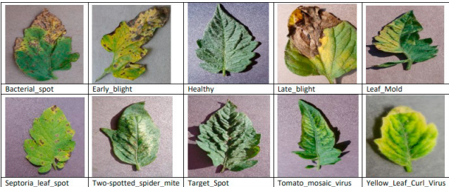
Results
1. Dataset: Tomato disease images are from the Plant Village dataset. Thisddataset contains over 50,000 of hisiimages of 14 crops including tomatoes, potatoes, grapes, apples, corn, blueberries, raspberries,ssoybeans, pumpkins and strawberries. Tomatoes were selected as the targetccrop. Here are pictures of the different classes of tomatoes (see diagram).
(link for theddataset :-https://data.mendeley.com/datasets/tywbtsjrjv/1)

Slide 14
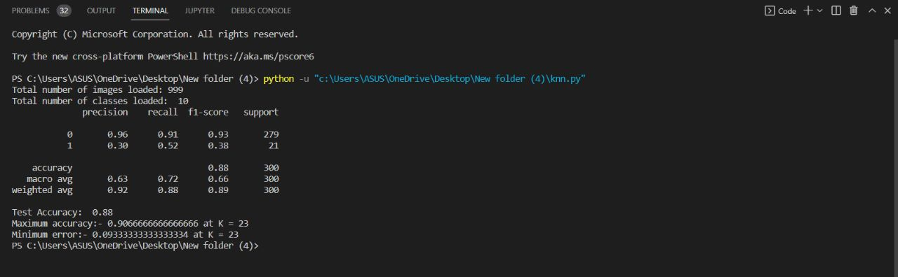
2. Using KNN:
Output:

Slide 15
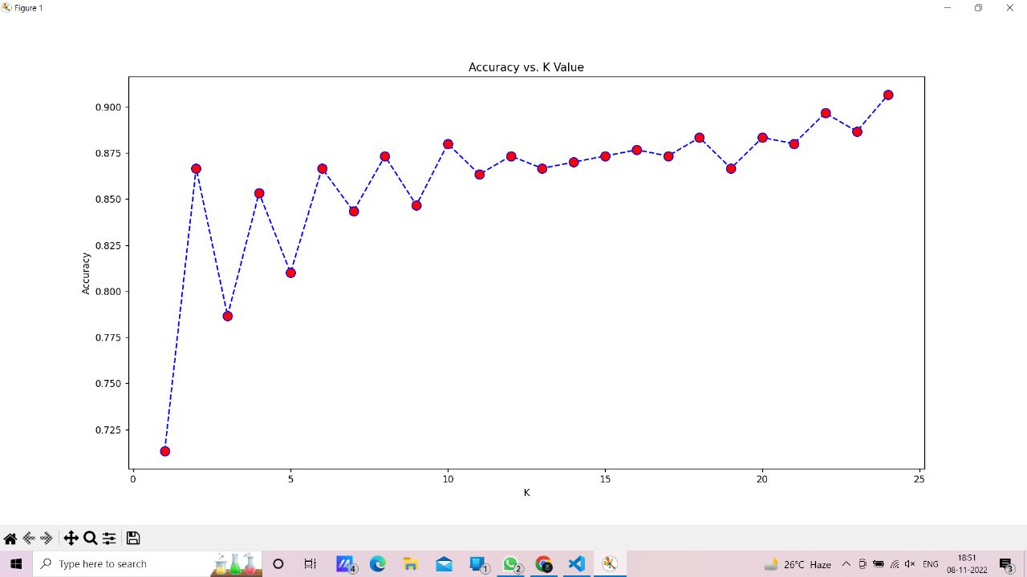
Visualizations :

Slide 16
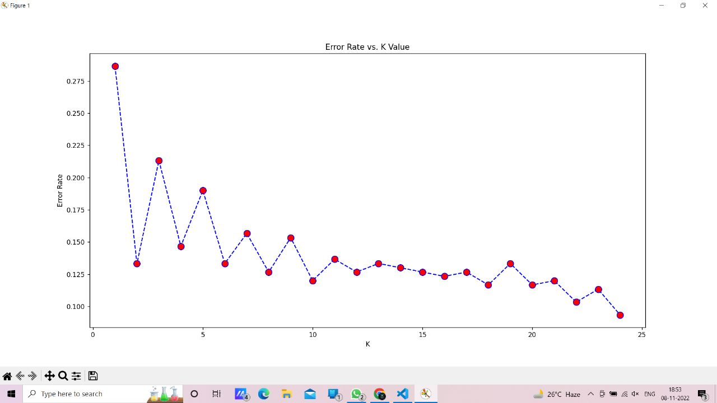

Slide 17
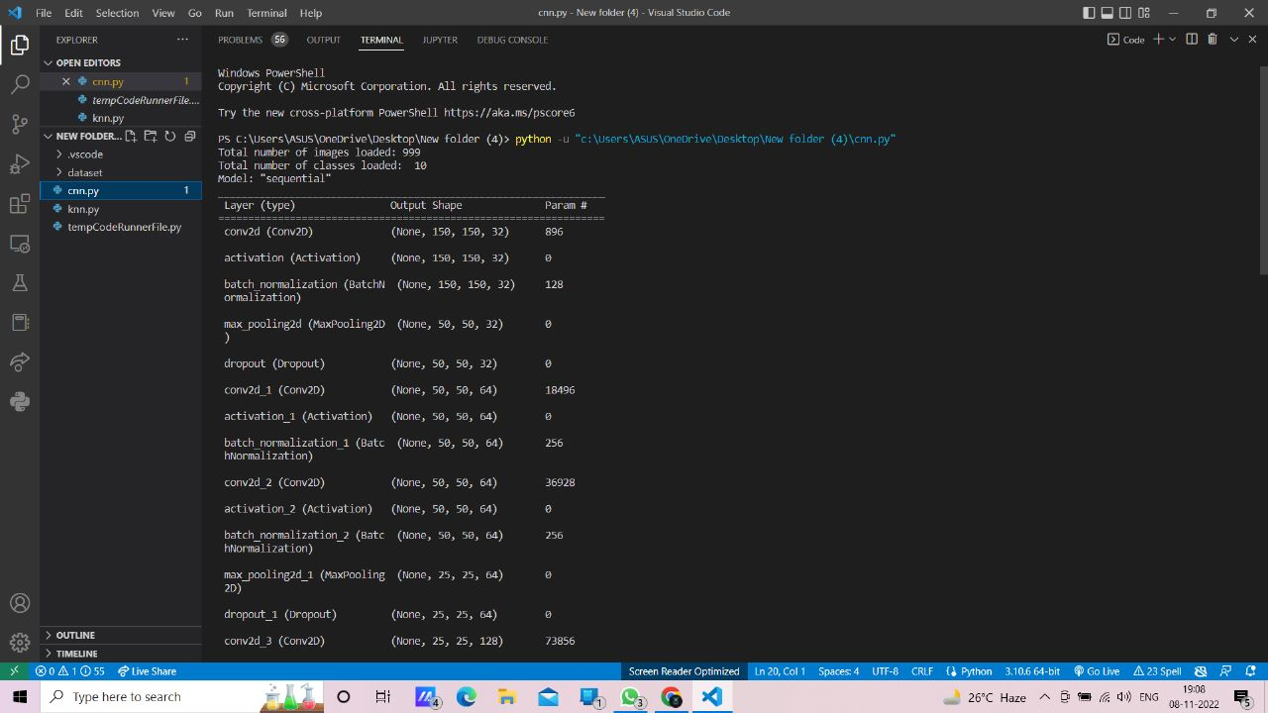
Using CNN :
Output:

Slide 18
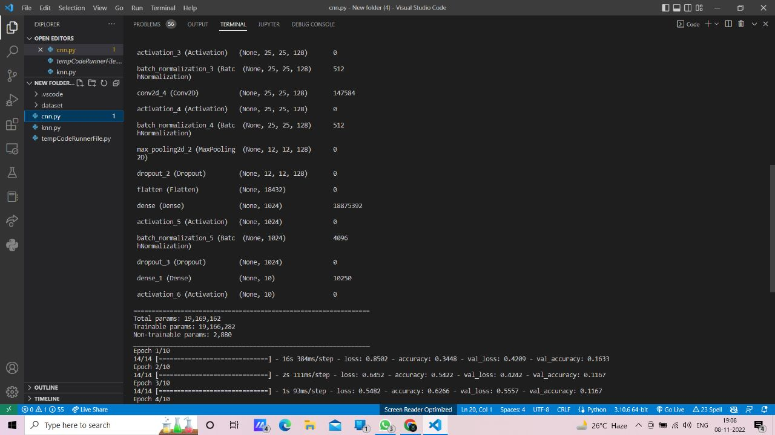

Slide 19
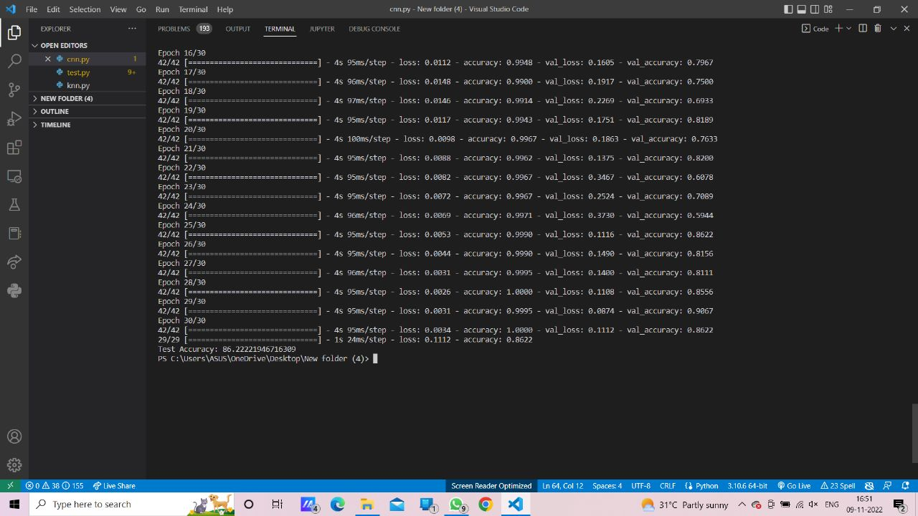

Slide 20
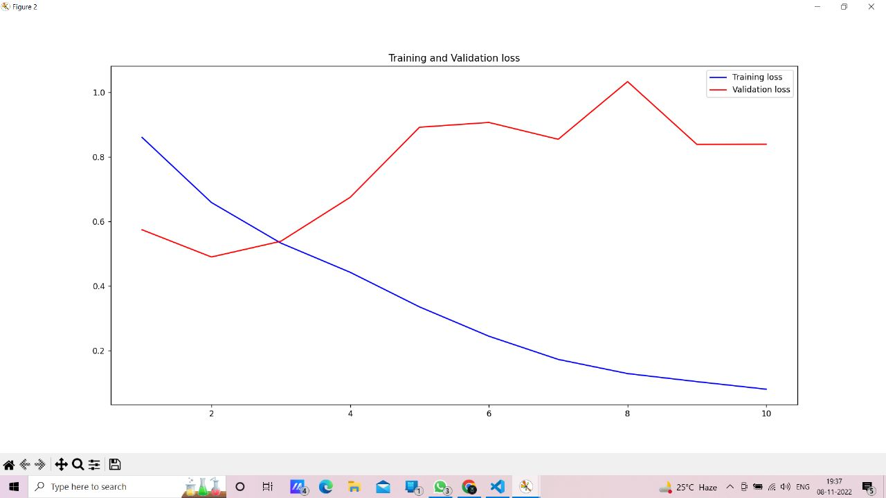
Visualization:

Slide 21
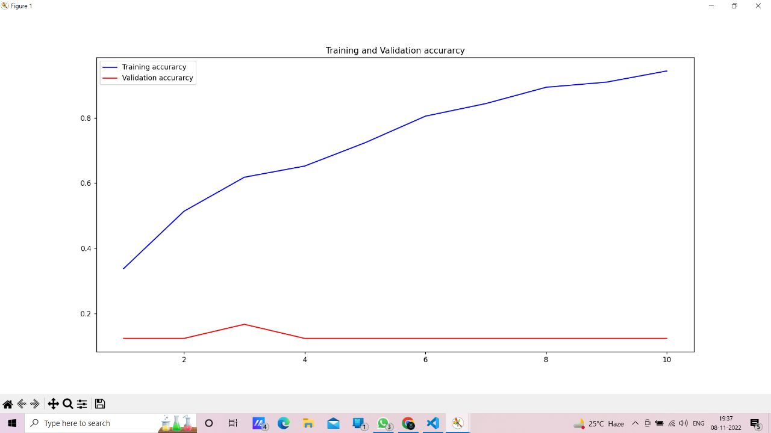

Slide 22
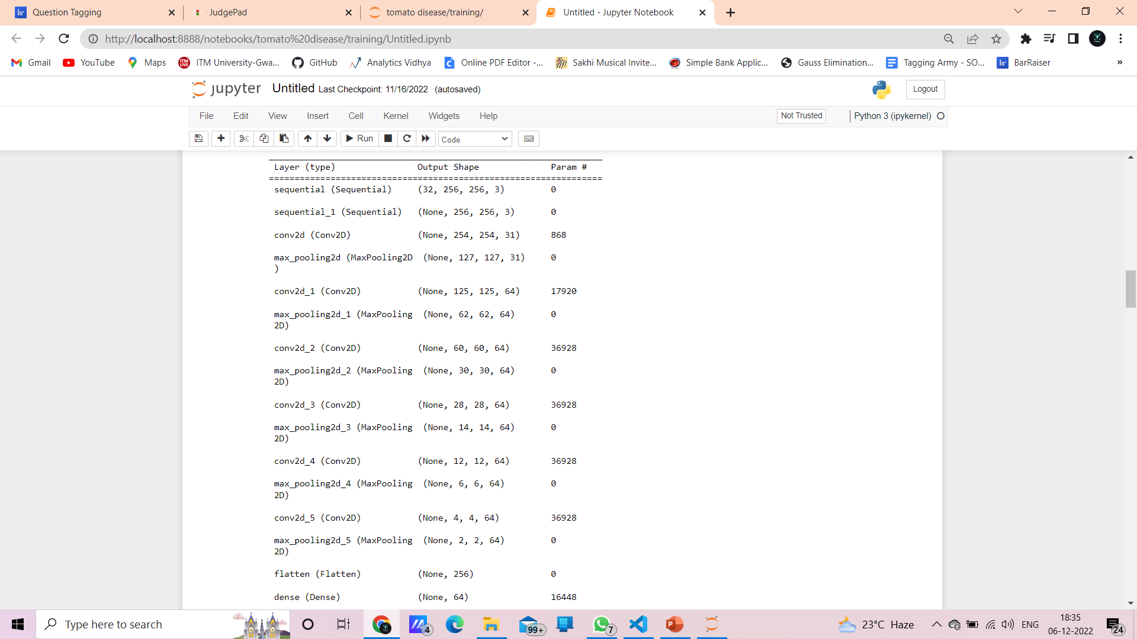
Prediction Model

Slide 23
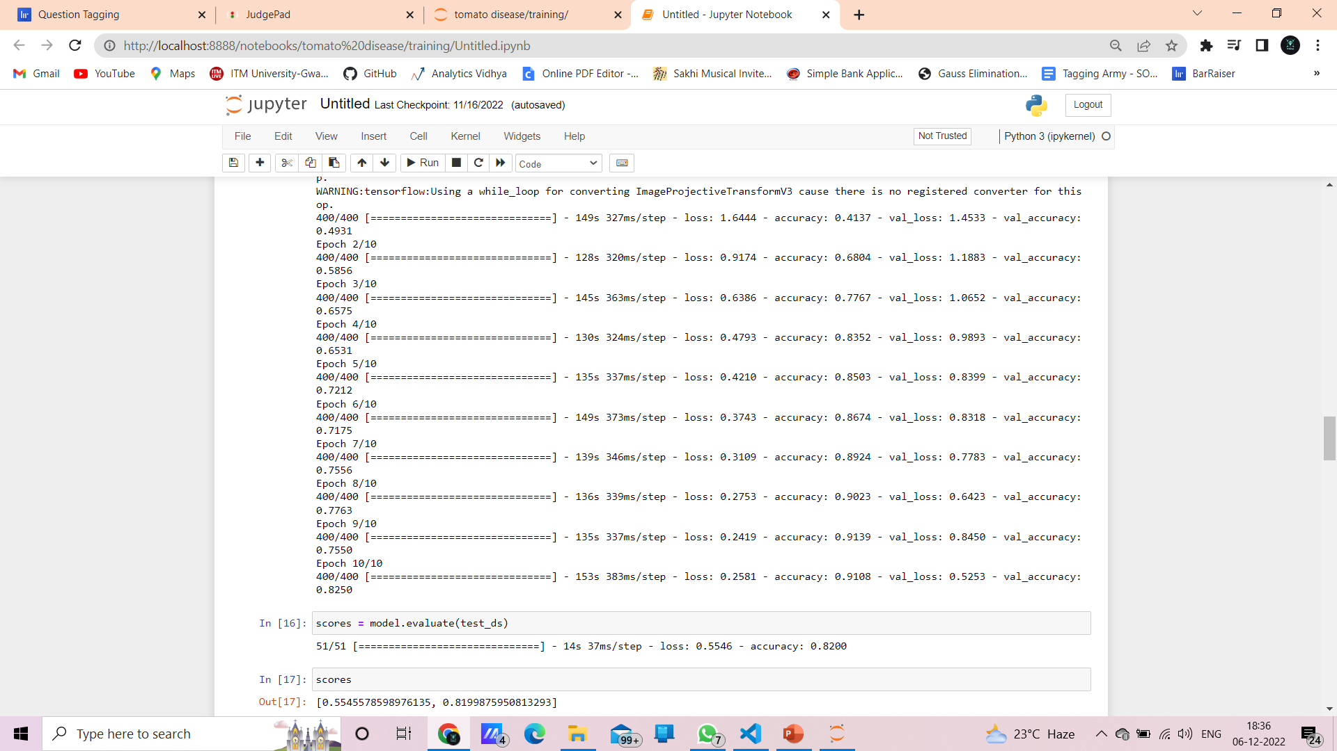

Slide 24
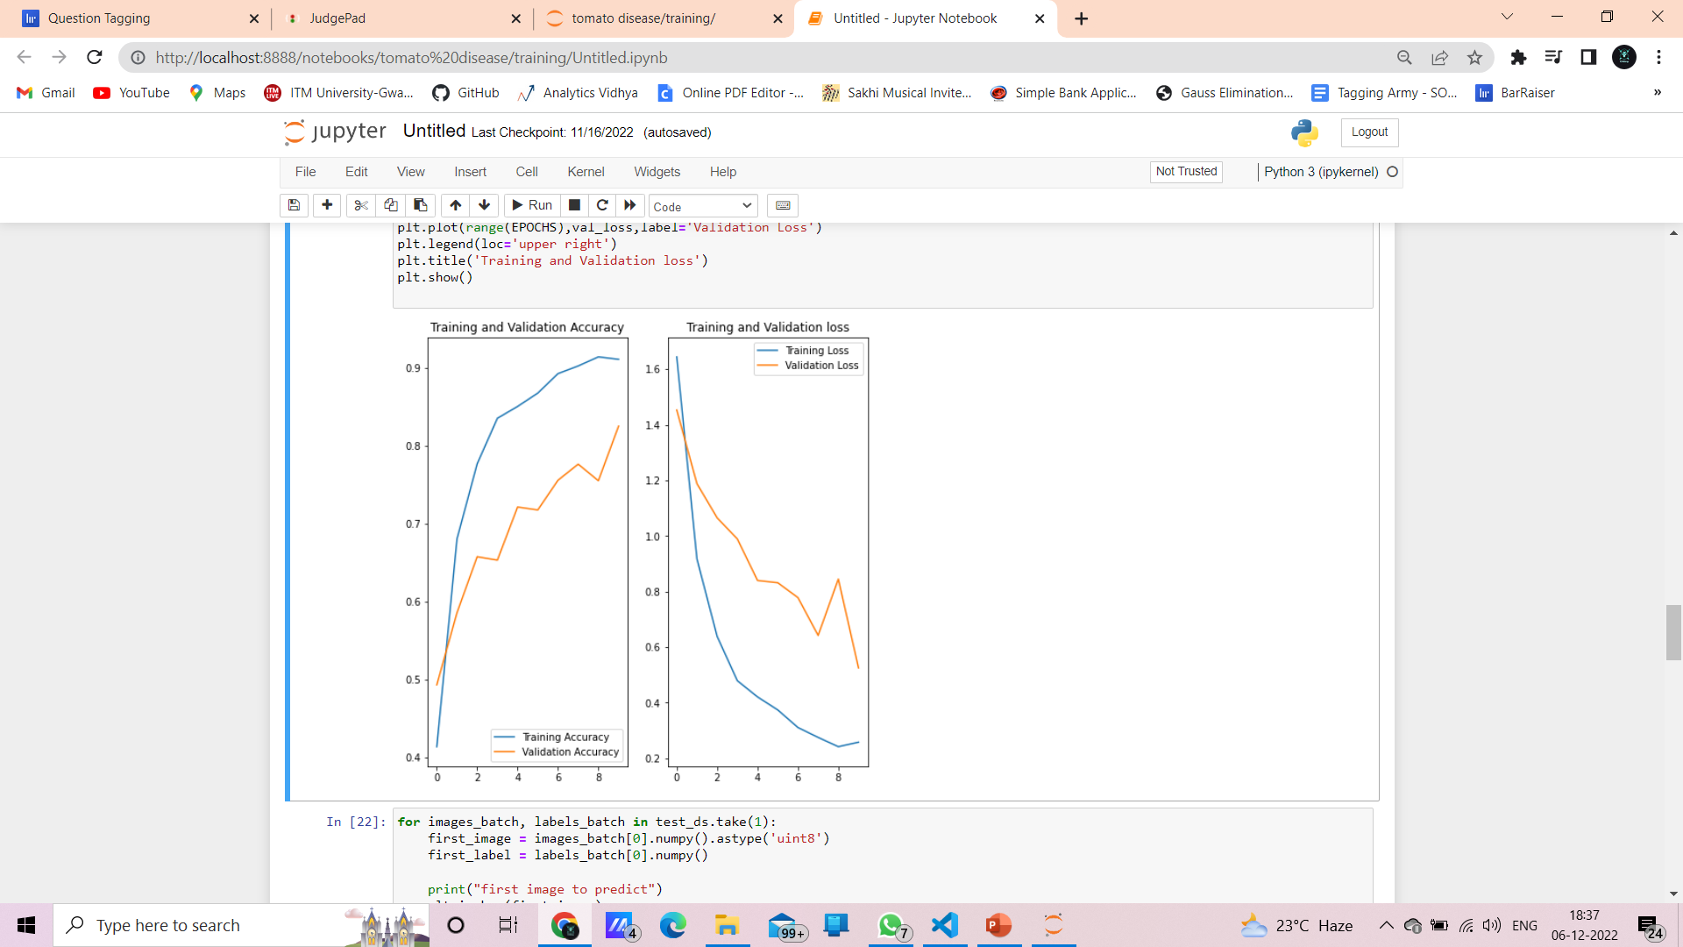

Slide 25
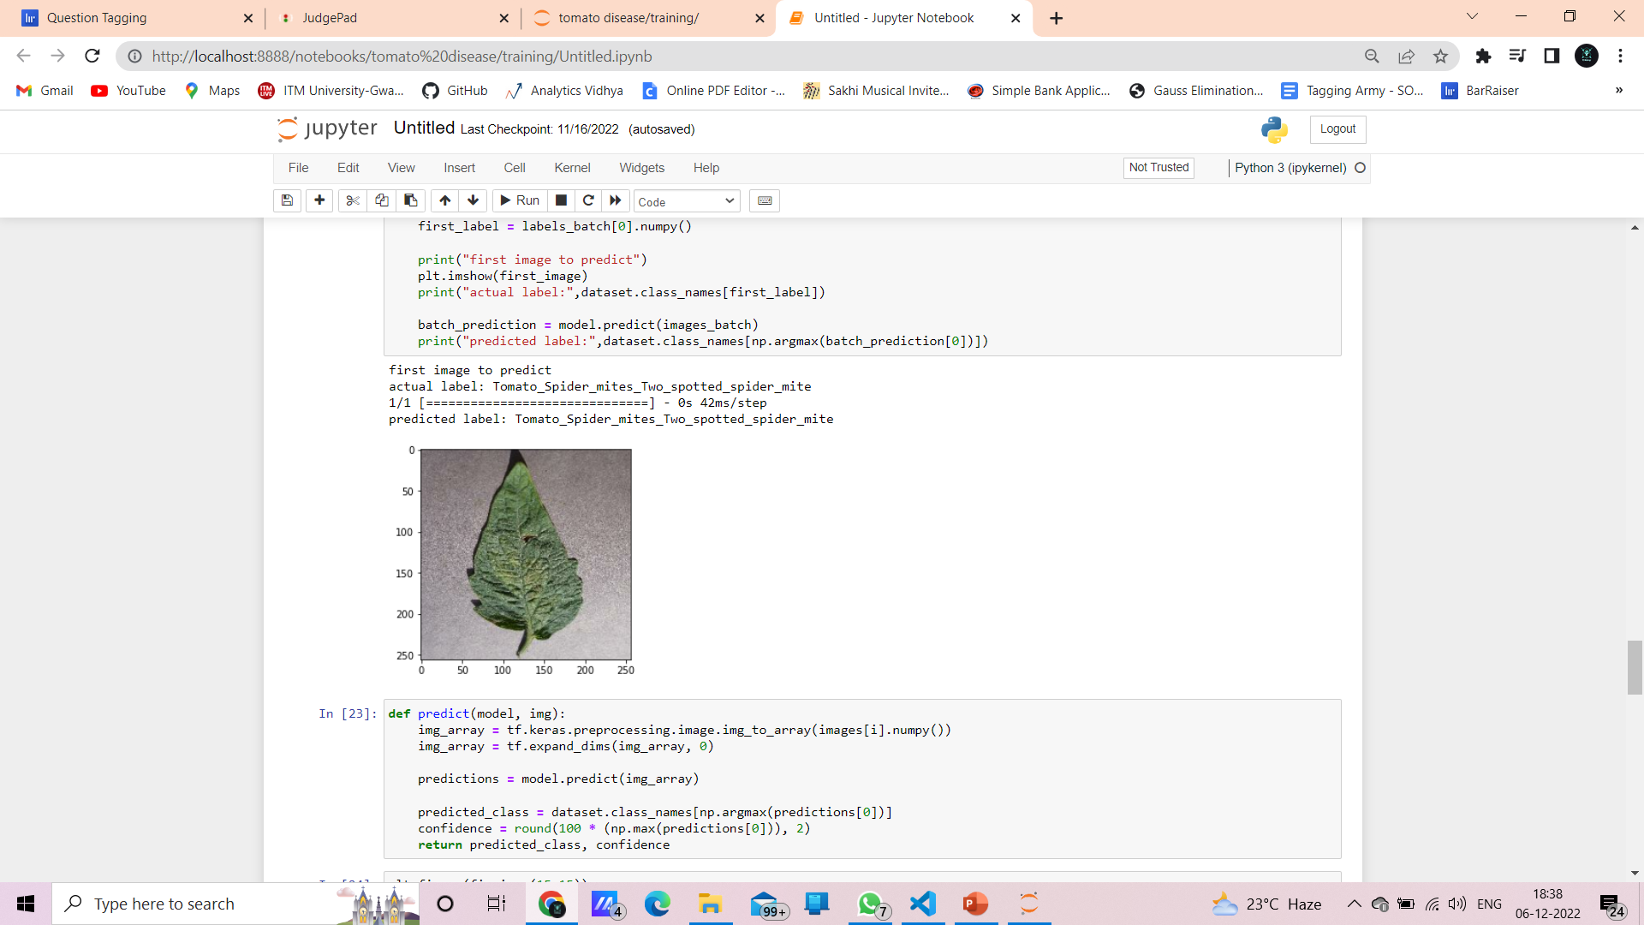

Slide 26
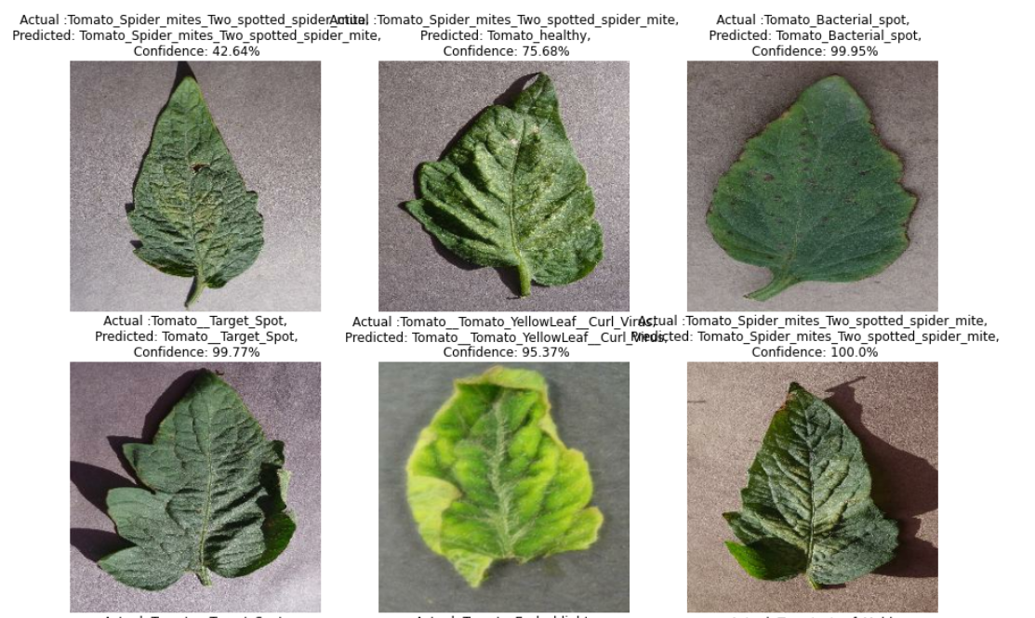

Slide 27
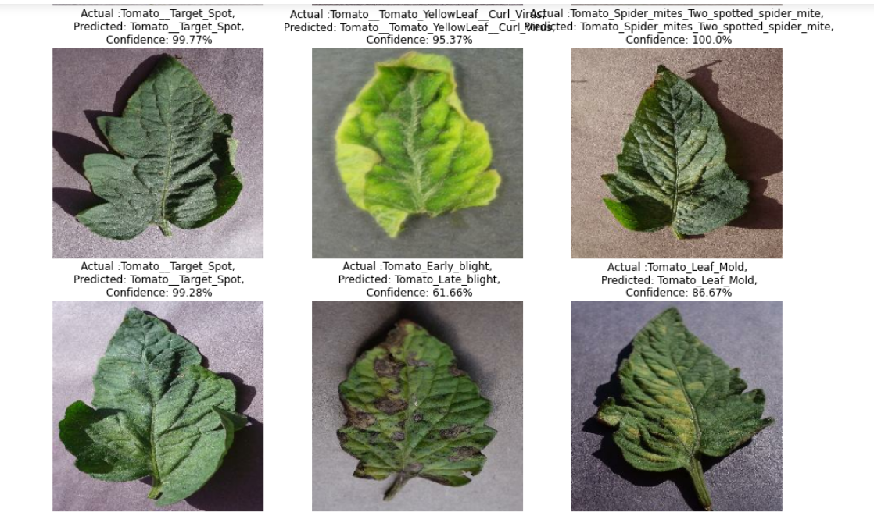

Slide 28
Conclusion
We considered an approach based on existing system functions. Imaging makes it possible There are many ways to identify crop diseases and suggest treatments. Each has some advantages and disadvantages. On the one hand, visual analytics is the cheapest and simplest method, but it is not very effective and reliable. Image processing is the most important technique, the main advantage of which is very high accuracy and minimal time consumption. Applications of K-means clustering and neural networks (NN) have been formulated for clustering and classification of plant leaf diseases. Accurate and efficient disease detection is the main goal of the proposed approach. The experimental results show that the proposed approach is a valuable approach that can significantly promote the accurate detection of foliar diseases with low computational effort.

Slide 29
Future Scope
• Hybrid algorithms such as artificial neural networks, Bayesian classifiers, and fuzzy logic can also be used to improve the recognition rate of the final classification process.
• Develop convenient and easy-to-use mobile applications.
• An extension of this work will focus on automatically estimating the severity of the detected disease.
• As a future extension of the project, once a disease is detected, an open multimedia (audio/video) about the disease and its solution will be automatically developed.

Slide 30
References
1. Crop disease investigation using imaging technology for rural economic growth. Yashpal Sen1, Chandra Shekhar Mithlesh2, Dr. Vivek Baghel3 2. Sandesh Raut, Karthik Ingale, A review of leaf disease detection using imaging techniques. 3. Methods for detecting plant diseases. Review of” Sagar Patil, Anjali Chandavale 4. T. RUMPF, A. K. Mahlein, U. sleiner, H. W. Dehne. "Texture analysis for rice disease diagnosis". International Conference on Electrical Engineering and Informatics, 2009. ICEEI'09.vol 1, pp. 23-27. IEEE, 2009.
5. “Detection and classification of plant leaf diseases using image processing techniques:” Savita N. Gaiwat, Parul Arora. 6. S Arivazhagan, R Newlin shebiah, S Ananthi, S Vishnu varthini “Detection of unhealthy areas on plant leaves and classification of plant leaf diseases by textural features.” 7. Suma VR Amog Shetty , Rishabh F Tated, Sunku Rohan, Triveni S. Pujar, “A CNN-based leaf disease identification and treatment recommendation system,” IEEE Conference Paper 2019. 8. Omkar Kulkarni、「Crop Disease Detection Using Deep Learning」、IEEE アクセス 2018. 9. Balakrishna K. Mahesh Rao、「Tomato Plant Leaves Disease Classification Using KNN and PNN」、International Journal of Computer Vision and Image Processing 2019。 10 Prajwala TM, AllaPranathi, Kandiraju Sai Ashritha, Nagaratna B. Chittaragi, Shashidhar G. Koolagudi, "Detection of Tomato Leaf Diseases Using Convolutional Neural Networks", Proceedings of the 11th International Conference on Modern Computing (IC3), 2018 Record, 2018. 11. K . Elangoran, S. Nalini, 2011. "Detection and classification of leaf diseases using K-means-based segmentation and neural network-based classification." Inform. Technology J., 10: 267-275. DOI: 10.3923/itj.2011.267

Slide 31
Thank You

